Slide 1
Differentiable Image Parameterizations
Itamar ordani
Eitan kosman

Slide 2
What is neural style transfer?
Optimization technique used to take 3 images and blend them together:
Content image
Style reference image
Input image
The result thrives to look like the content image, while mimicking the style of the style reference image.

Slide 3
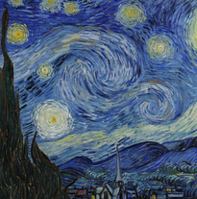
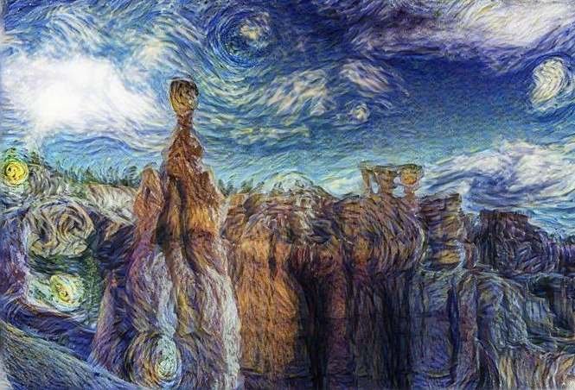
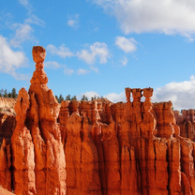
Examples
Style reference
Content image

Slide 4
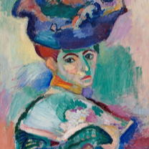
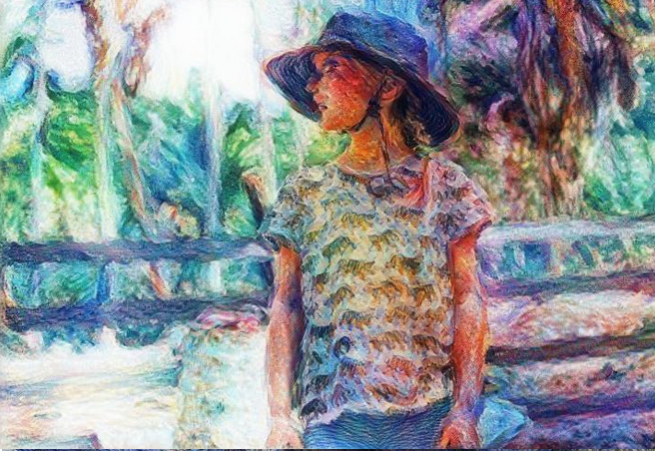
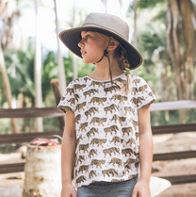
Examples
Style reference
Content image

Slide 5
The article – Main topics
Why does parameterization matters
Style transfer with non-VGG architectures
Feature visualization in 3D
Style transfer in 3D

Slide 6
Why does parameterization matters?
Control the basin of attraction of each minima, change the sizes of different basins of attraction and influence the likely result.
Impose additional constraints on the optimization problem. The optimizer is subject to the constraints of the parameterization.
Enables optimizing different objects other than images
Notes:
Basin of attraction – which minima we will converge to
Additional constraints example – black border, different spaces…
Different object – 3D objects for example

Slide 7
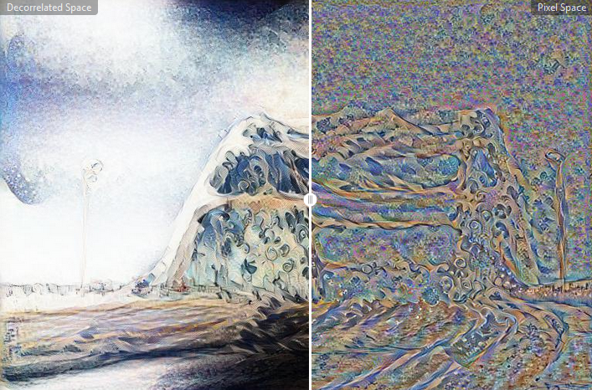
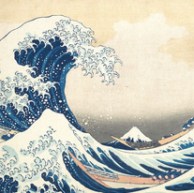

Comparison
Style reference
Content image

Slide 8
Style transfer with non-VGG architectures
VGG is a deep CNN used for object recognition developed by a group in Oxford named Visual Geometry Group (VGG).
In the paper, the authors show how the InceptionV1 model can be used instead with satisfying results.
Notes:
Why VGG?
One suggested explanation is that VGG’s large size causes it to capture information that other models discard. This extra information, the hypothesis goes, isn’t helpful for classification, but it does cause the model to work better for style transfer.
other models downsample more aggressively than VGG, losing spatial information.
there may be another factor: most modern vision models have checkerboard artifacts in their gradient , which could make optimization of the stylized image more difficult.

Slide 9

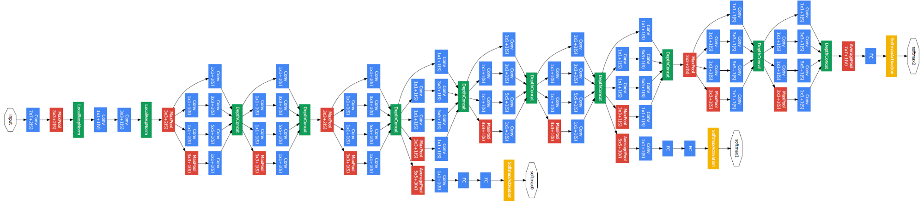
VGG16
InceptionV1

Slide 10
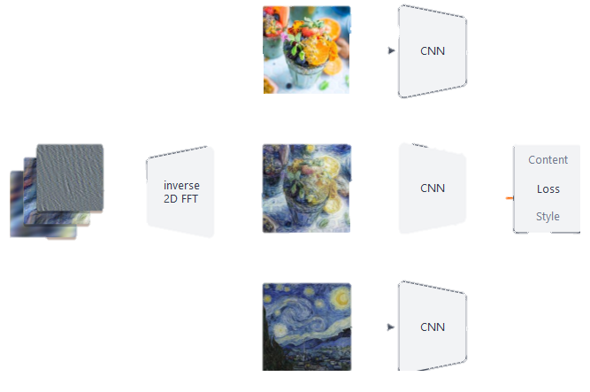
Style transfer Implementation in the article
The content objective aims to get neurons to fire in the same position as they did for the content image.
The style objective aims to create similar patterns of neuron activation as in the style image — without regard to position.
Parameterizing the learned image in a decorrelated space makes style transfer more robust to choice of model.
Content image
learned image
Style reference
Notes:
Decorrelated space – Neighboring elements are independent

Slide 11
differentiable parameters in the problem
In this problem, we try to optimize the input image with respect to a given loss function.
The loss function is defined by how strongly the neurons react to the learned input compared to their reaction to the content + style images.
For optimizing, we must firstly choose a method.
By examing the problem we can notice that all the parameters are differentiable, including the parameterization. Therefore, the problem can be easily solved by gradient descent for example.

Slide 12
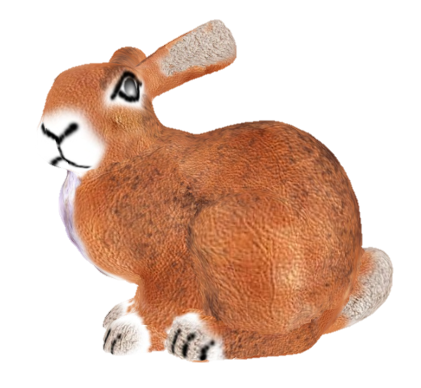
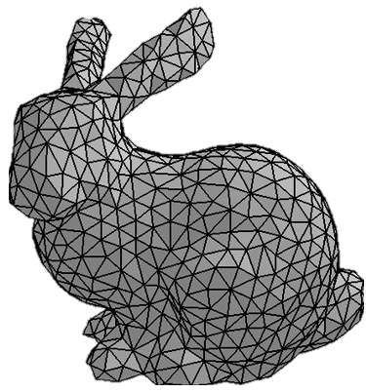
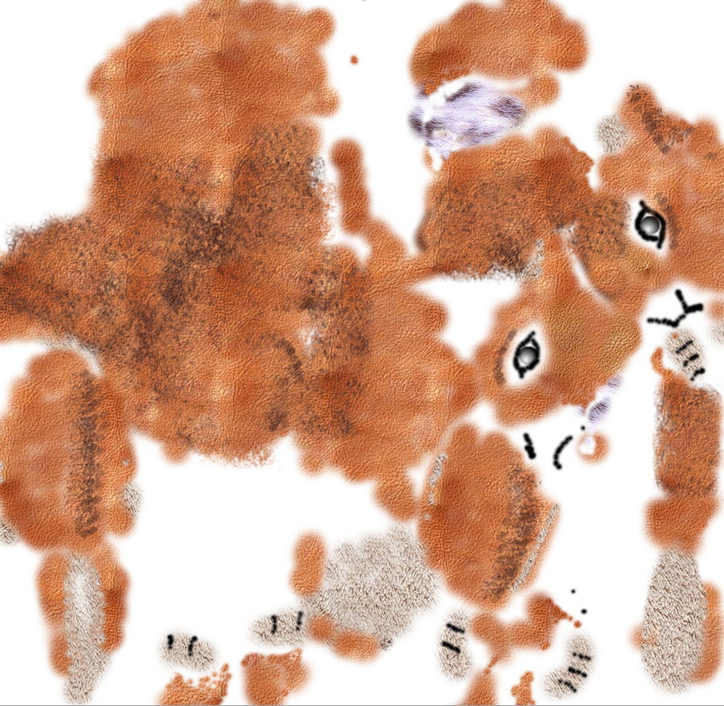

3d rendering in a nutshell
The object’s geometry is usually saved as a collection of interconnected triangles called mesh. To render a realistic model, a texture is painted over the mesh. The texture is saved as an image that is applied to the model by using the so called UV-mapping. Every vertex $c_{i}$ in the mesh is associated to a $\left(u_{i},v_{i}\right)$ coordinate in the texture image. The model is then rendered, i.e. drawn on screen, by coloring every triangle with the region of the image that is delimited by the $(u,v)$ coordinates of its vertices.

Slide 13
Style transfer in 3D

Slide 14
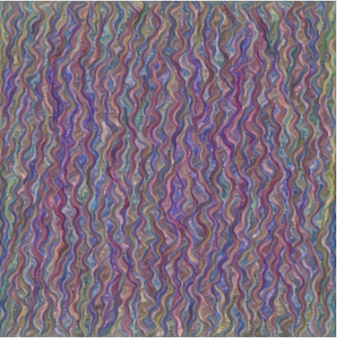
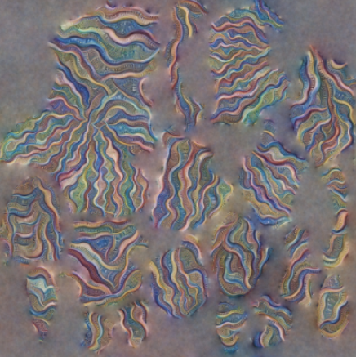
The problem
We would like to apply the style transfer technique on a 3d object.
Naïve solution: apply style transfer on the texture as a standalone image.
The naïve approach doesn’t work!

Slide 15
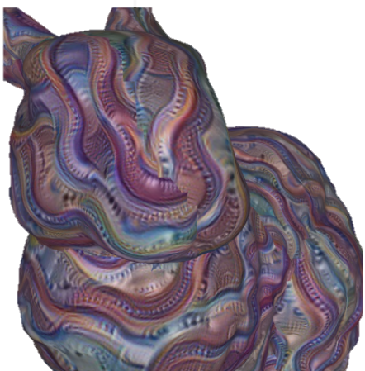
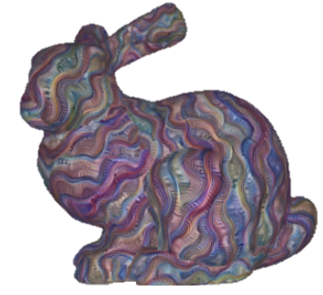
Naïve approach

Slide 16
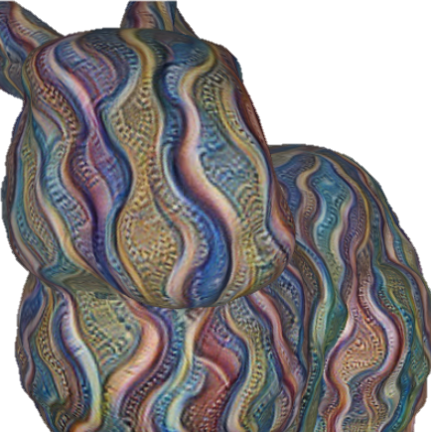
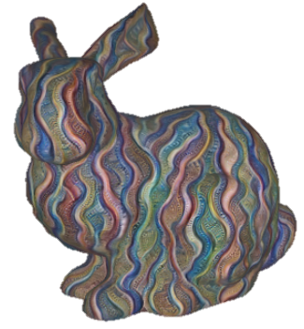
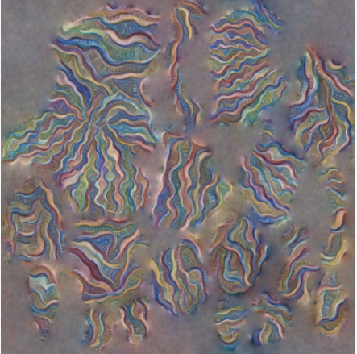
The Author’s approach
NO SEAMS!

Slide 17
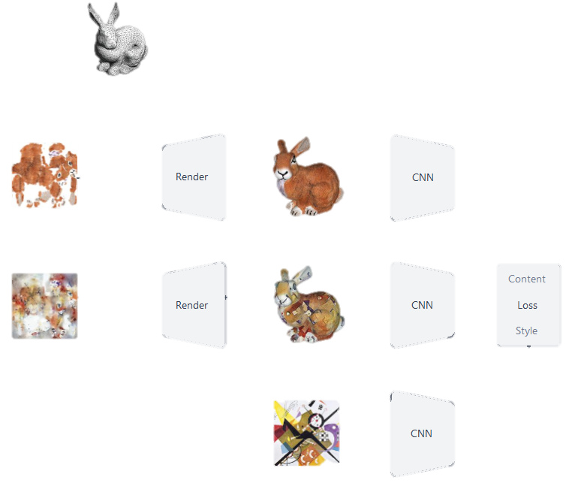
At each iteration, a random view point, oriented toward the center of the object, is sampled and two images are rendered: one with the original texture, and one with the texture that we are currently optimizing.
After the images are rendered, the algorithm optimizes for the style-transfer objective function introduced by Gatys.
The parameterization is mapped back in the UV-mapped texture(we know the reverse mapping). The procedure is then iterated until the desired blend of content and style is obtained in the target texture.
Original texture
Content image
Learned texture
learned image
style image

Slide 18
The results

Slide 19
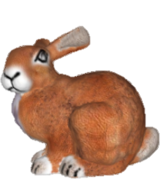
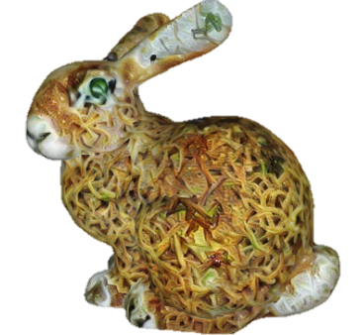
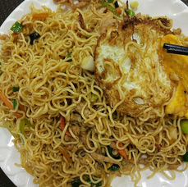
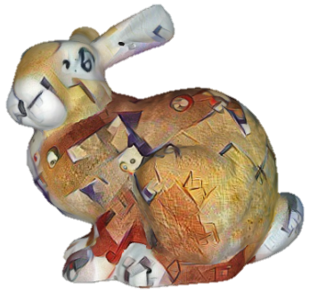
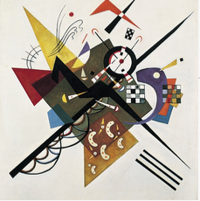

Slide 20
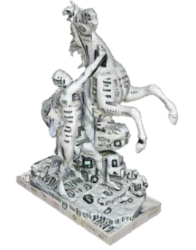
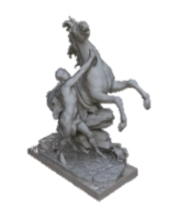
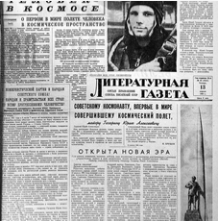
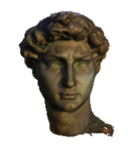
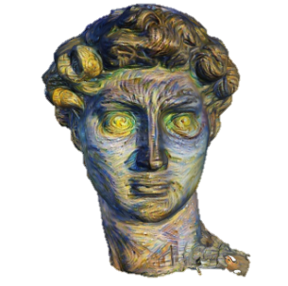
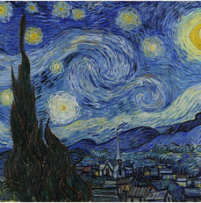

Slide 21
Contributions
An Atari Model Zoo for Analyzing, Visualizing, and Comparing Deep Reinforcement Learning Agents.
Interactive CPPNs in GLSL.

Slide 22
Limitations
The article focuses on differentiable image parameterizations, because they are easy to optimize and cover a wide range of possible applications.
We’ll see some examples which didn’t turn out as well…

Slide 23
INSERT COOL PICS

